Slide 1

RURAL ARTISANS MARKETING APP
DEPARTMENT OF COMPUTER SCIENCE AND ENGINEERING
GE19612-PROFESSIONAL READINESS FOR INNVOATION, EMPLOYABILITY AND ENTREPRENEURSHIP
Dr. T. KUMARAGURUBARAN
ADHARSHINI C - 210701014
AMIRDHA M - 210701026
PROFESSOR

Slide 2
ABSTRACT:
The Rural Artisans Marketing Website connects rural Indian craftsmen with a wider audience, aiding them in overcoming market challenges. With separate logins for administrators, sellers, and buyers, the platform streamlines transactions. Artisans can easily manage their businesses through personalized dashboards, showcasing products and tracking inventory. Buyers have access to diverse traditional crafts with detailed listings and images. Marketing initiatives like sales and discounts drive engagement, while admin tools ensure smooth operation. Through technology, the platform promotes economic sustainability and preserves cultural heritage.

Slide 3
PROBLEM STATEMENT:
At the moment, traditional means of selling handicrafts local markets, intermediaries, sporadic exhibitions, word-of-mouth recommendations, and a small web presence are the main sources of income for rural artisans.
Limited online presence: Many rural artists currently have limited online presence, relying on local markets or word-of-mouth to showcase and sell their work.
Limited reach to customer: Reaching a broader customer base has been a challenge for many rural artists due to limited marketing resources and distribution channels reaching only local customers.
Intermediaries: Depending on middleman for reaching customers. Middlemen help sell products but reduce artisans' profits.

Slide 4
PROPOSED SYSTEM:
The proposed system is a Rural Artisans Marketing Website with separate logins for administrators, sellers, and buyers. This platform empowers rural craftsmen to market and sell their handicraft products directly to a global audience, eliminating the need for intermediaries and ensuring fair compensation for their work.
Three Distinct Logins:
Administrator: Manages data, monitors user activity, and ensures smooth operation of the platform.
Seller: Allows artisans to create personalized accounts, display products, set prices, track inventory, and manage their business ventures.
Buyer: Facilitates the exploration and purchase of a diverse range of traditional products with detailed listings and images.

Slide 5
ADVANTAGES
DIRECT COMMUNICATION
Facilitates direct interaction between buyers and artisans.
Artisans can share their products online, fostering deeper connections with customers.
Exhibition Management
Enables artisans to participate in offline events and showcase their products to a wider audience.
Integration with event management platforms allows easy registration, stall booking, and access to information about upcoming events.

Slide 6
ADVANTAGES
User-Friendly Interface
Easy registration and login process for both buyers and sellers.
Intuitive navigation and comprehensive product listings enhance user experience.
Safe payment gateways ensure convenient and secure transactions for both buyers and sellers.
Marketing Strategies
Features like sales, discounts, and promotions encourage product exploration and purchases.
Enhances product visibility and attracts a larger customer base.

Slide 7
MODULES:
The module description section details the website's key features for marketing rural artisans. This segmentation ensures a comprehensive understanding of the system's architecture and interactions.
The rural artisans marketing website comprises five modules.
USER AUTHENTICATION MODULE
PRODUCT MANAGEMENT MODULE
ORDER PROCESSING MODULE
SEARCH AND FILTERING
EXHIBITION MANAGEMENT MODULE

Slide 8
USER AUTHENTICATION
Enables user account creation, login, and profile management
Implements strong authentication techniques:
Password hashing
Session management
Ensures data privacy and protects against unauthorized access
Builds user confidence and fosters a seamless, safe user experience
PRODUCT MANAGEMENT
Simplifies creation, organization, and display of rural artisans' goods
Craftsperson-friendly interface for uploading product listings with detailed descriptions, high-quality images, and pricing
Advanced features like inventory tracking, tag management, and categorization enhance product discovery
Centralizes product management for effective showcasing of rural craftsmen's items

Slide 9
ORDER PROCESSING MODULE:
Automates the entire online purchase process
Offers multiple payment methods and real-time order tracking
Creates invoices, adjusts inventory levels, and maintains order details
Provides order status alerts for customer convenience
Improves customer satisfaction and encourages repeat business
Handles order placement, payment processing, and order fulfillment efficiently
SEARCH AND FILTERING MODULE:
Enhances user navigation and product discovery
Delivers accurate and relevant search results in real-time
Allows users to refine search queries based on various criteria
Enables fast identification of items of interest
Simplifies product navigation and discovery through keyword-based search and filtering features

Slide 10
EXHIBITION MANAGEMENT MODULE:
Facilitates rural craftsmen's participation in live events and exhibitions
Enables artists to browse upcoming exhibits, obtain event details, and reserve booths
Simplifies exhibition logistics, including stall allocation
Promotes community participation and economic progress
Fosters community engagement and economic growth through physical events
Functionalities:
Listing upcoming exhibitions with location, date, and organizer information
Booking and registration of stalls for artisans interested in participation
Browsing and viewing information about exhibitions for users.

Slide 11
MODULE DESCRIPTION
ARTIST/SELLER
Profile Creation: Enables rural craftsmen to create and manage their profiles, including personal information, bio, and portfolio.
Order Upload: Allows artists to upload product listings with detailed descriptions, high-quality images, and pricing.
Exhibition Viewing: Provides information about upcoming exhibitions, including location, date, and organizer details, allowing artists to browse and view exhibition opportunities.
Stall Booking: Facilitates the reservation of booths for participating in exhibitions, allowing artists to book stalls to showcase their goods to a wider audience.
CUSTOMER
Profile Creation: Enables customers to create and manage their profiles, including personal information, shipping addresses, and preferences.
Order Viewing: Allows customers to view their order history, including past purchases and order status updates.
Add to Cart: Enables customers to add products to their shopping cart for future purchase.
Buy Product: Allows customers to complete the purchase process by selecting items from their cart and proceeding to checkout.
View Exhibition: Provides information about upcoming exhibitions, including location, date, and participating artisans, allowing customers to browse and plan their attendance.

Slide 12
DEVELOPMENTAL ENVIRONMENT
TECHSTACK
Development tool: PHP : Hypertext Preprocessor, JavaScript, Ajax
Data Base server: MySQL
SOFTWARE REQUIREMENT
Browser (Google Chrome recommended).
Xampp
HARDWARE REQUIREMENT
PC with
I5 or above processor
8GB RAM
Hard drive with at least 100GB of ROM
Windows 7 or above 64-bit OS

Slide 13
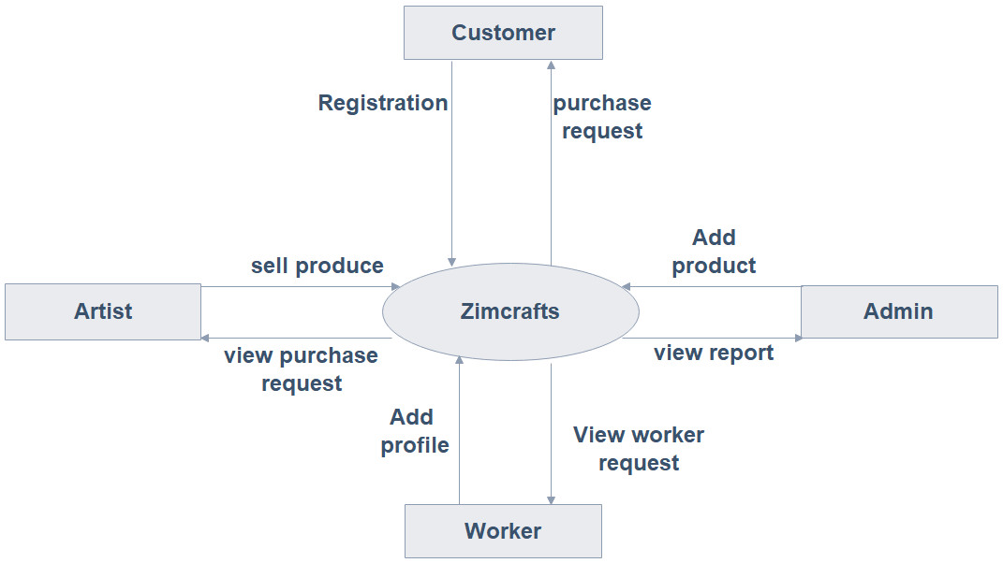
SYSTEM DESIGN
ARTISANS WEBSITE

Slide 14
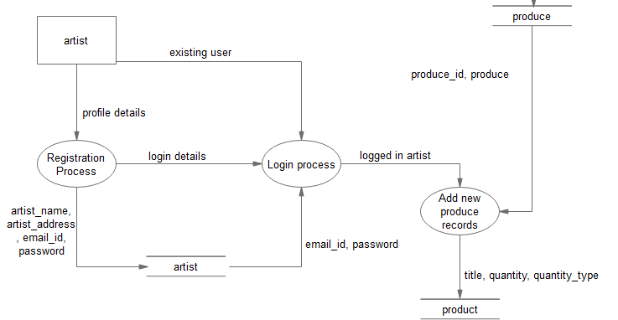
SYSTEM DESIGN - ARTIST

Slide 15
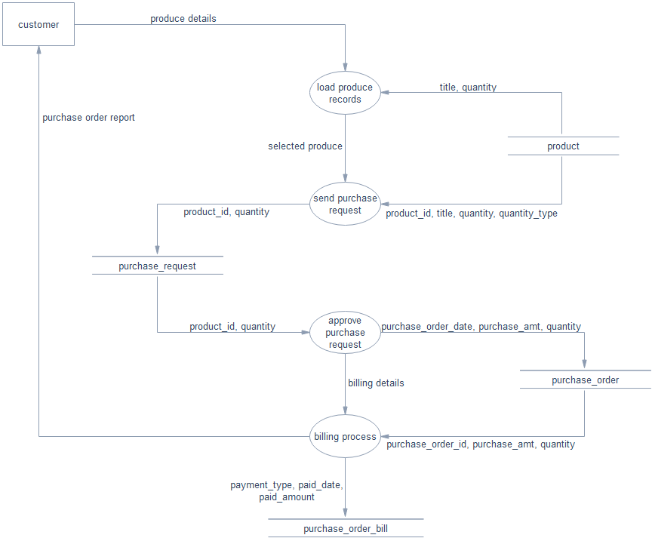
SYSTEM DESIGN - CUTOMER

Slide 16
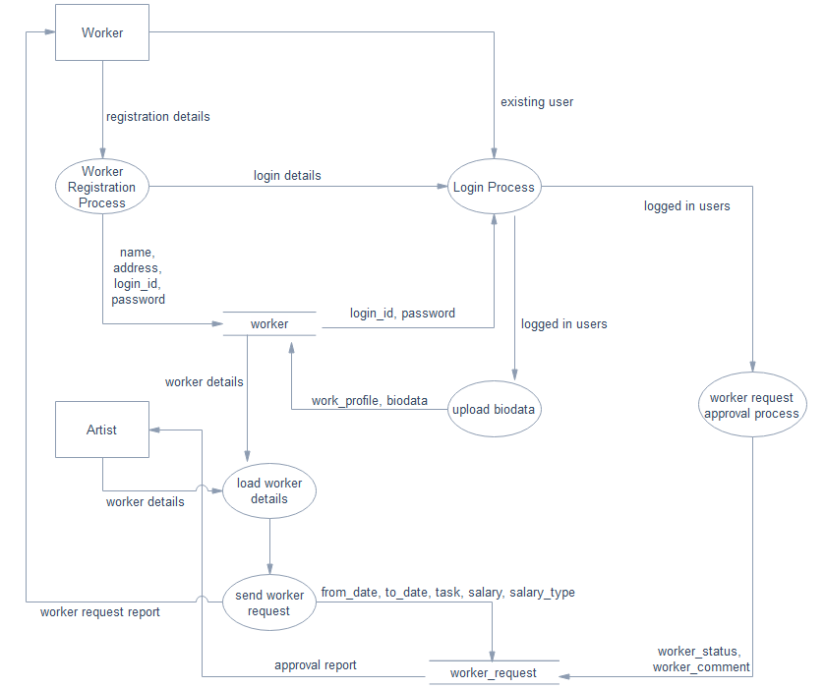
SYSTEM DESIGN - WORKER

Slide 17
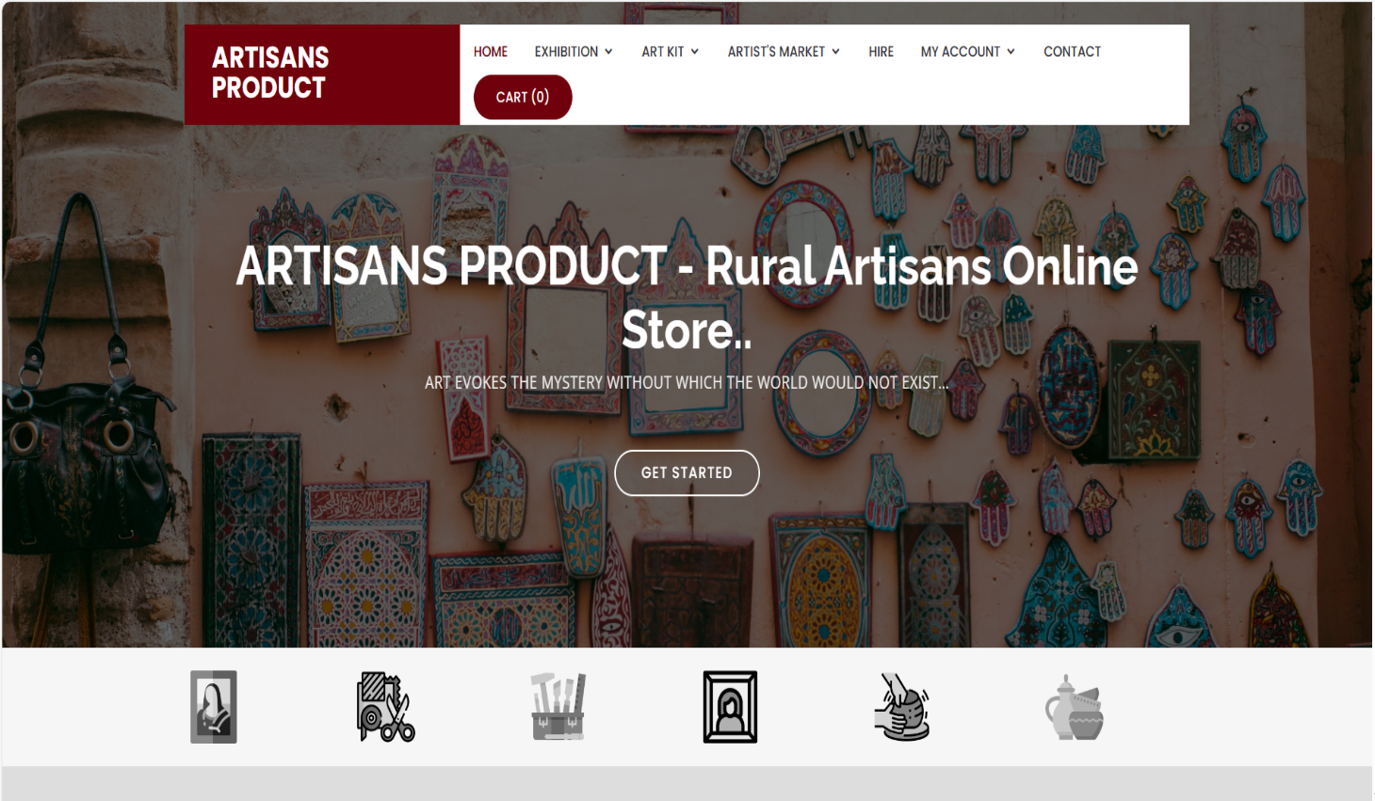
OUTPUT
HOME PAGE

Slide 18
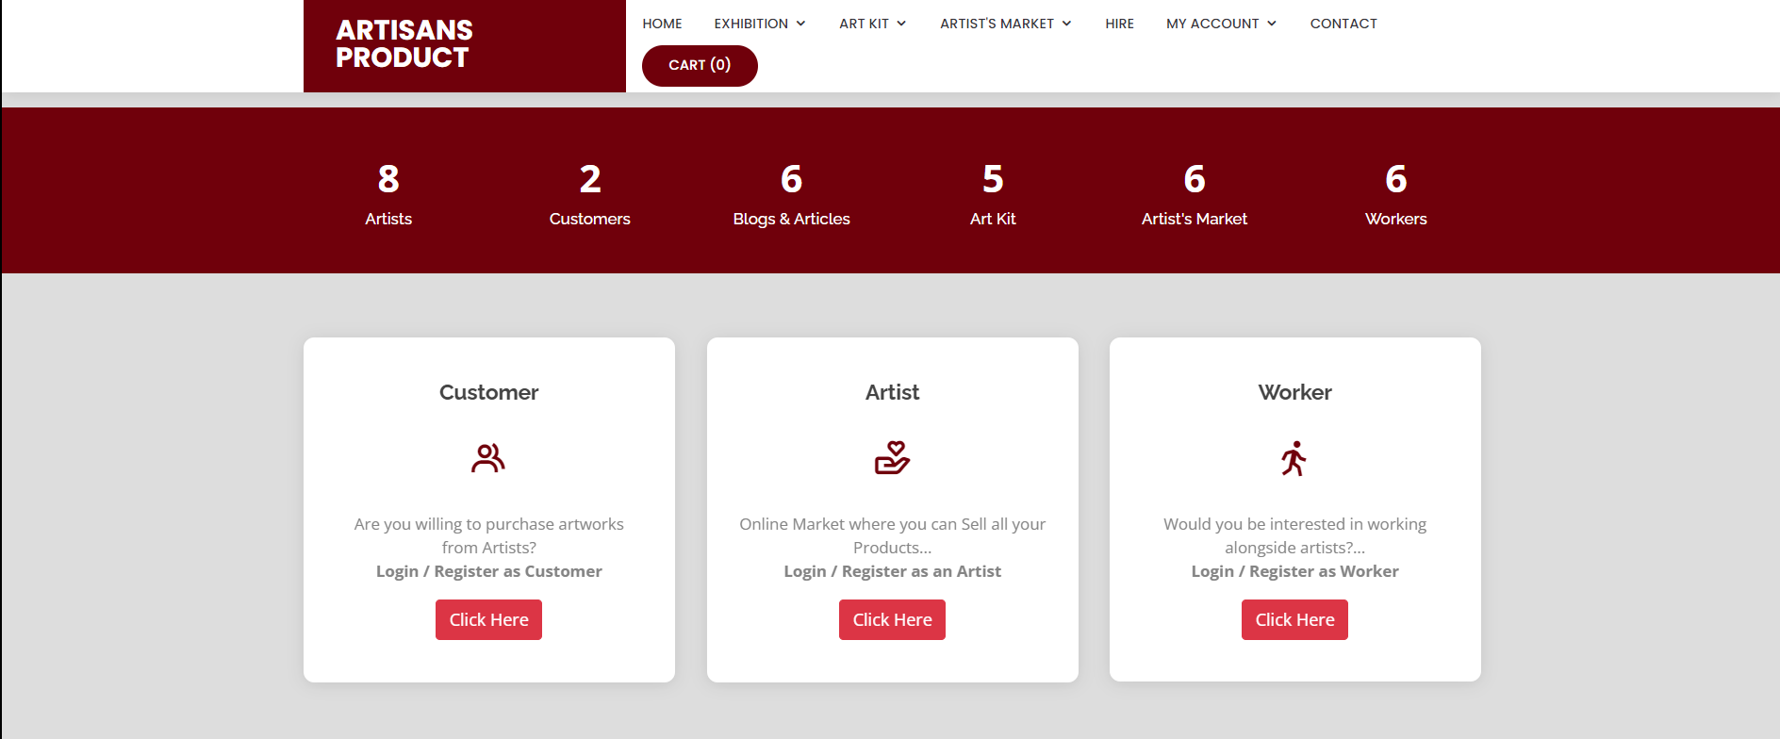
OUTPUT
LOGIN PAGE

Slide 19
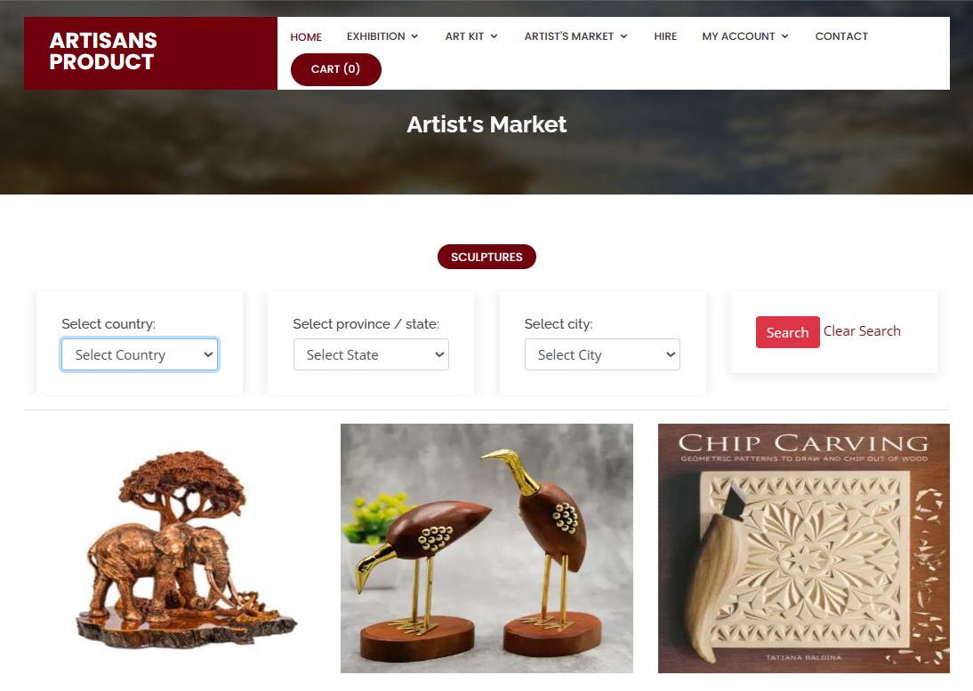
OUTPUT-CUSTOMER LOGIN

Slide 20
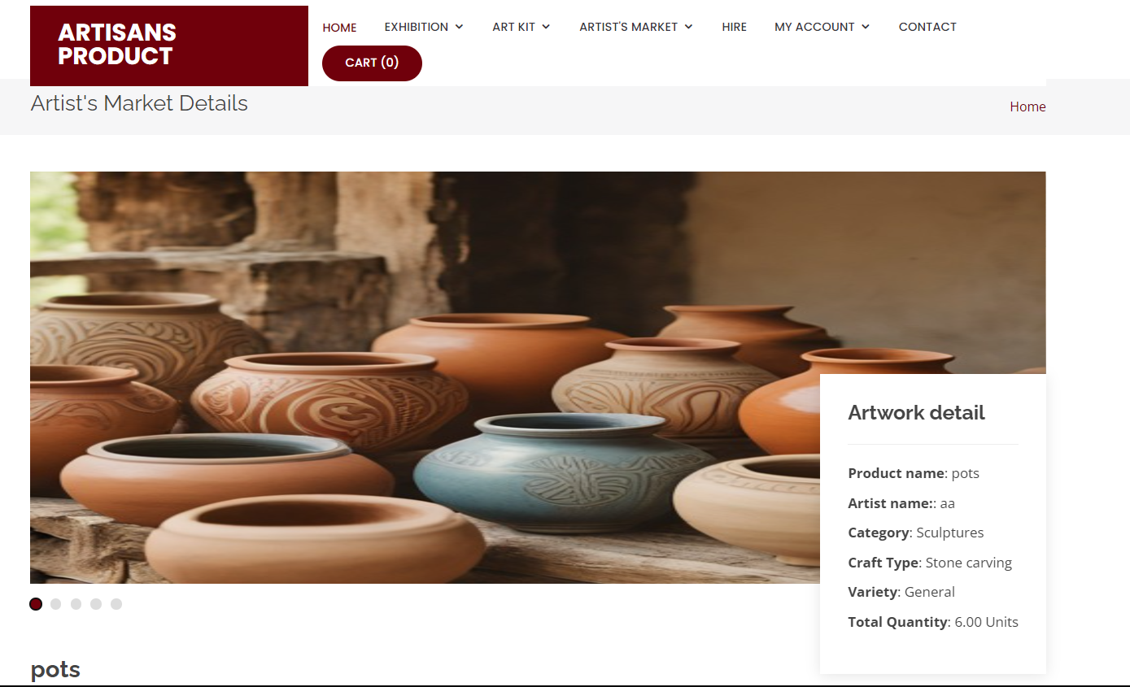
OUTPUT

Slide 21
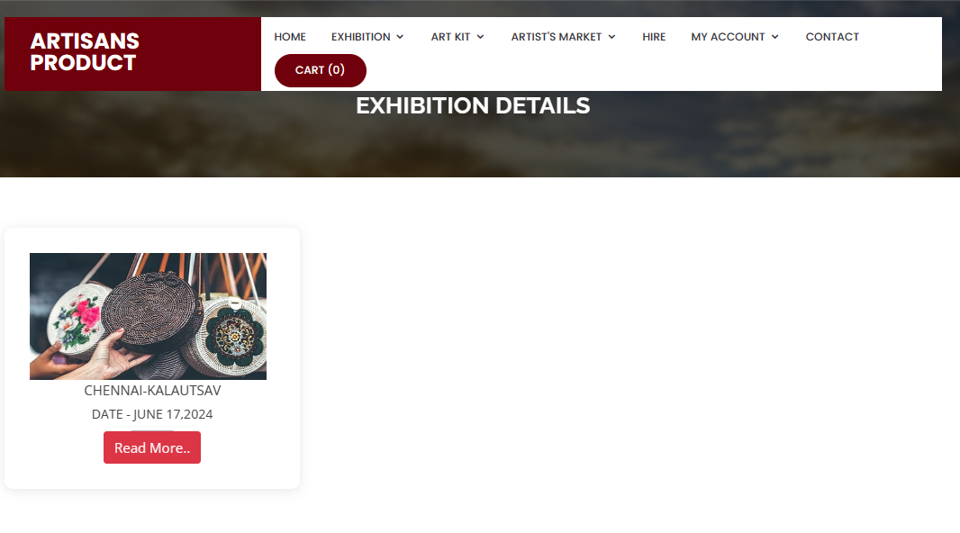
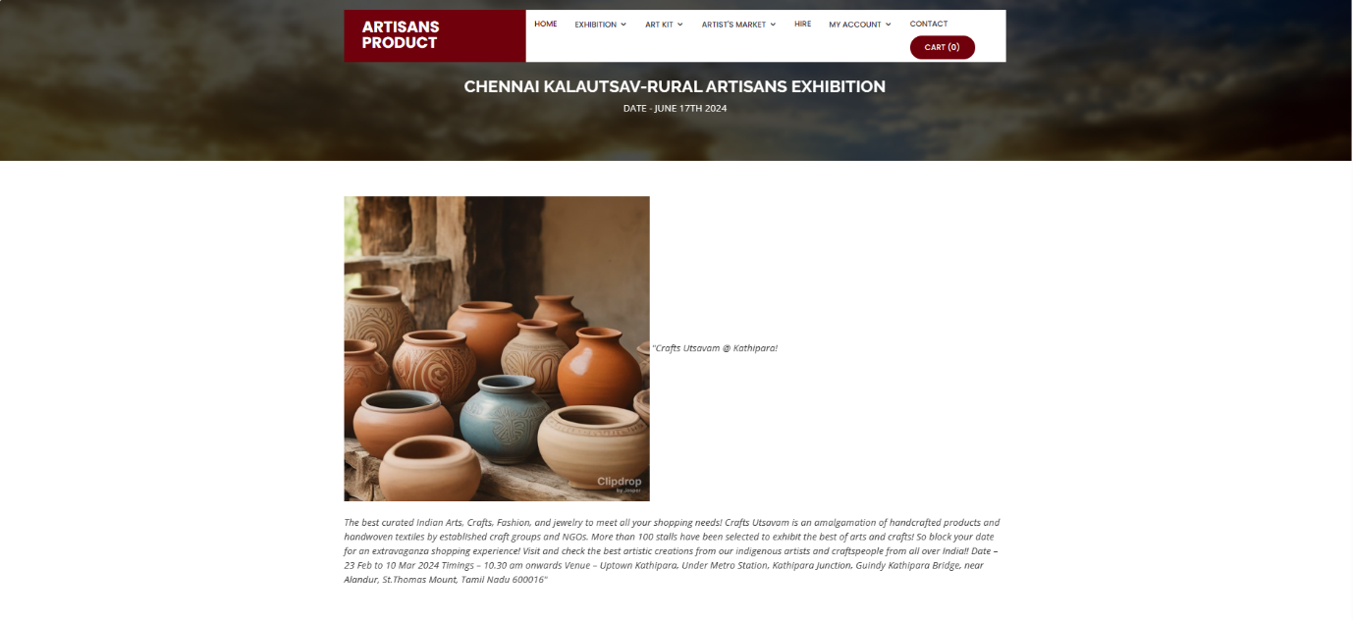
OUTPUT
EXHIBITION DETAILS

Slide 22
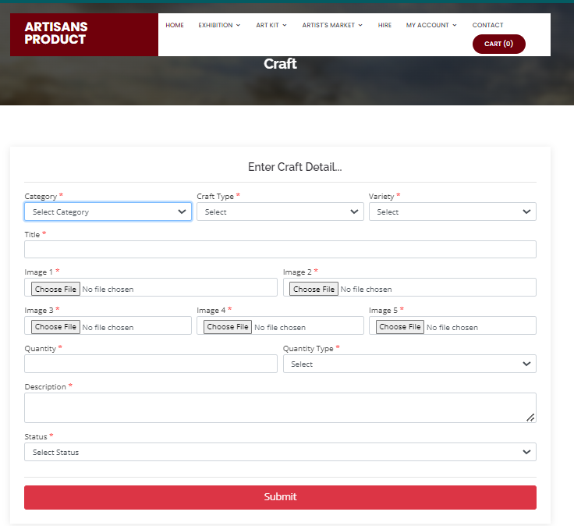
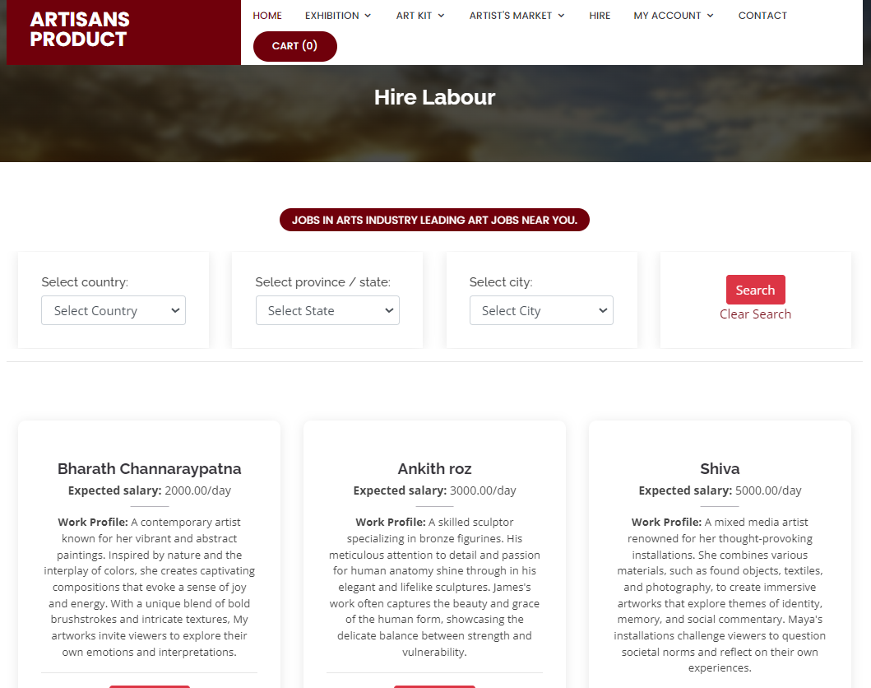
OUTPUT-ARTIST LOGIN

Slide 23
CONCLUSION & FUTURE ENHANCEMENT
The rural artisans marketing website breaks barriers, empowering craftsmen globally while preserving cultural heritage. It fosters economic growth, social change, and community empowerment through inclusive digital platforms.
Exhibition automation: Integrate with event management platforms to dynamically update exhibition listings and streamline stall booking processes.
AR/VR integration: Enhance user experience by allowing virtual product visualization and immersive storytelling, fostering deeper engagement with traditional arts and culture.

Slide 24
THANK YOU

